Slide 1







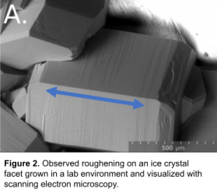
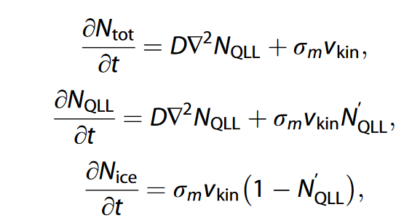
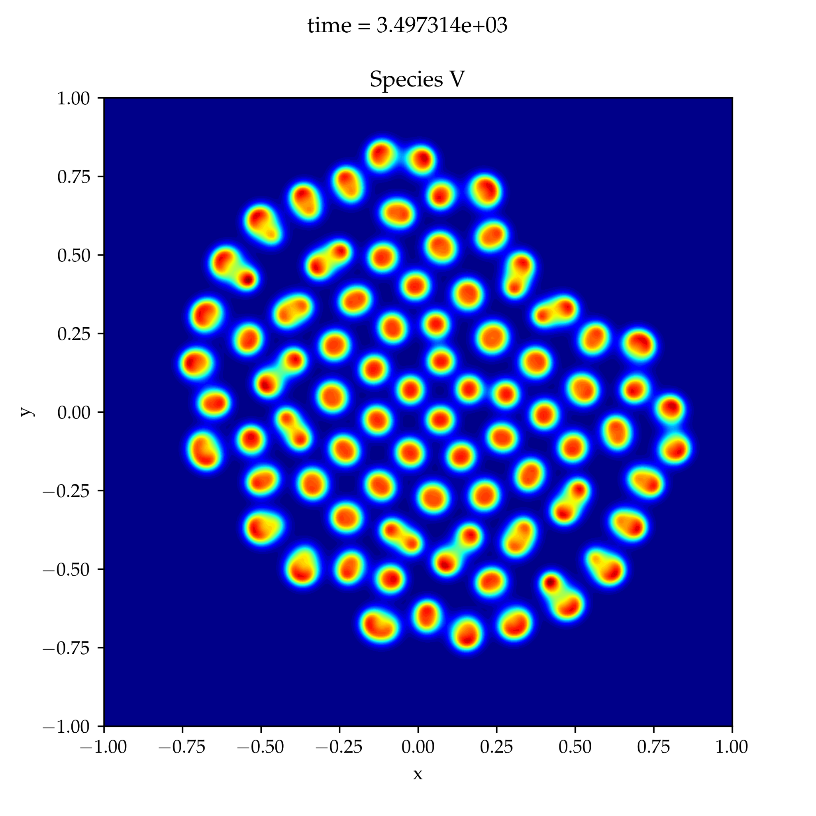
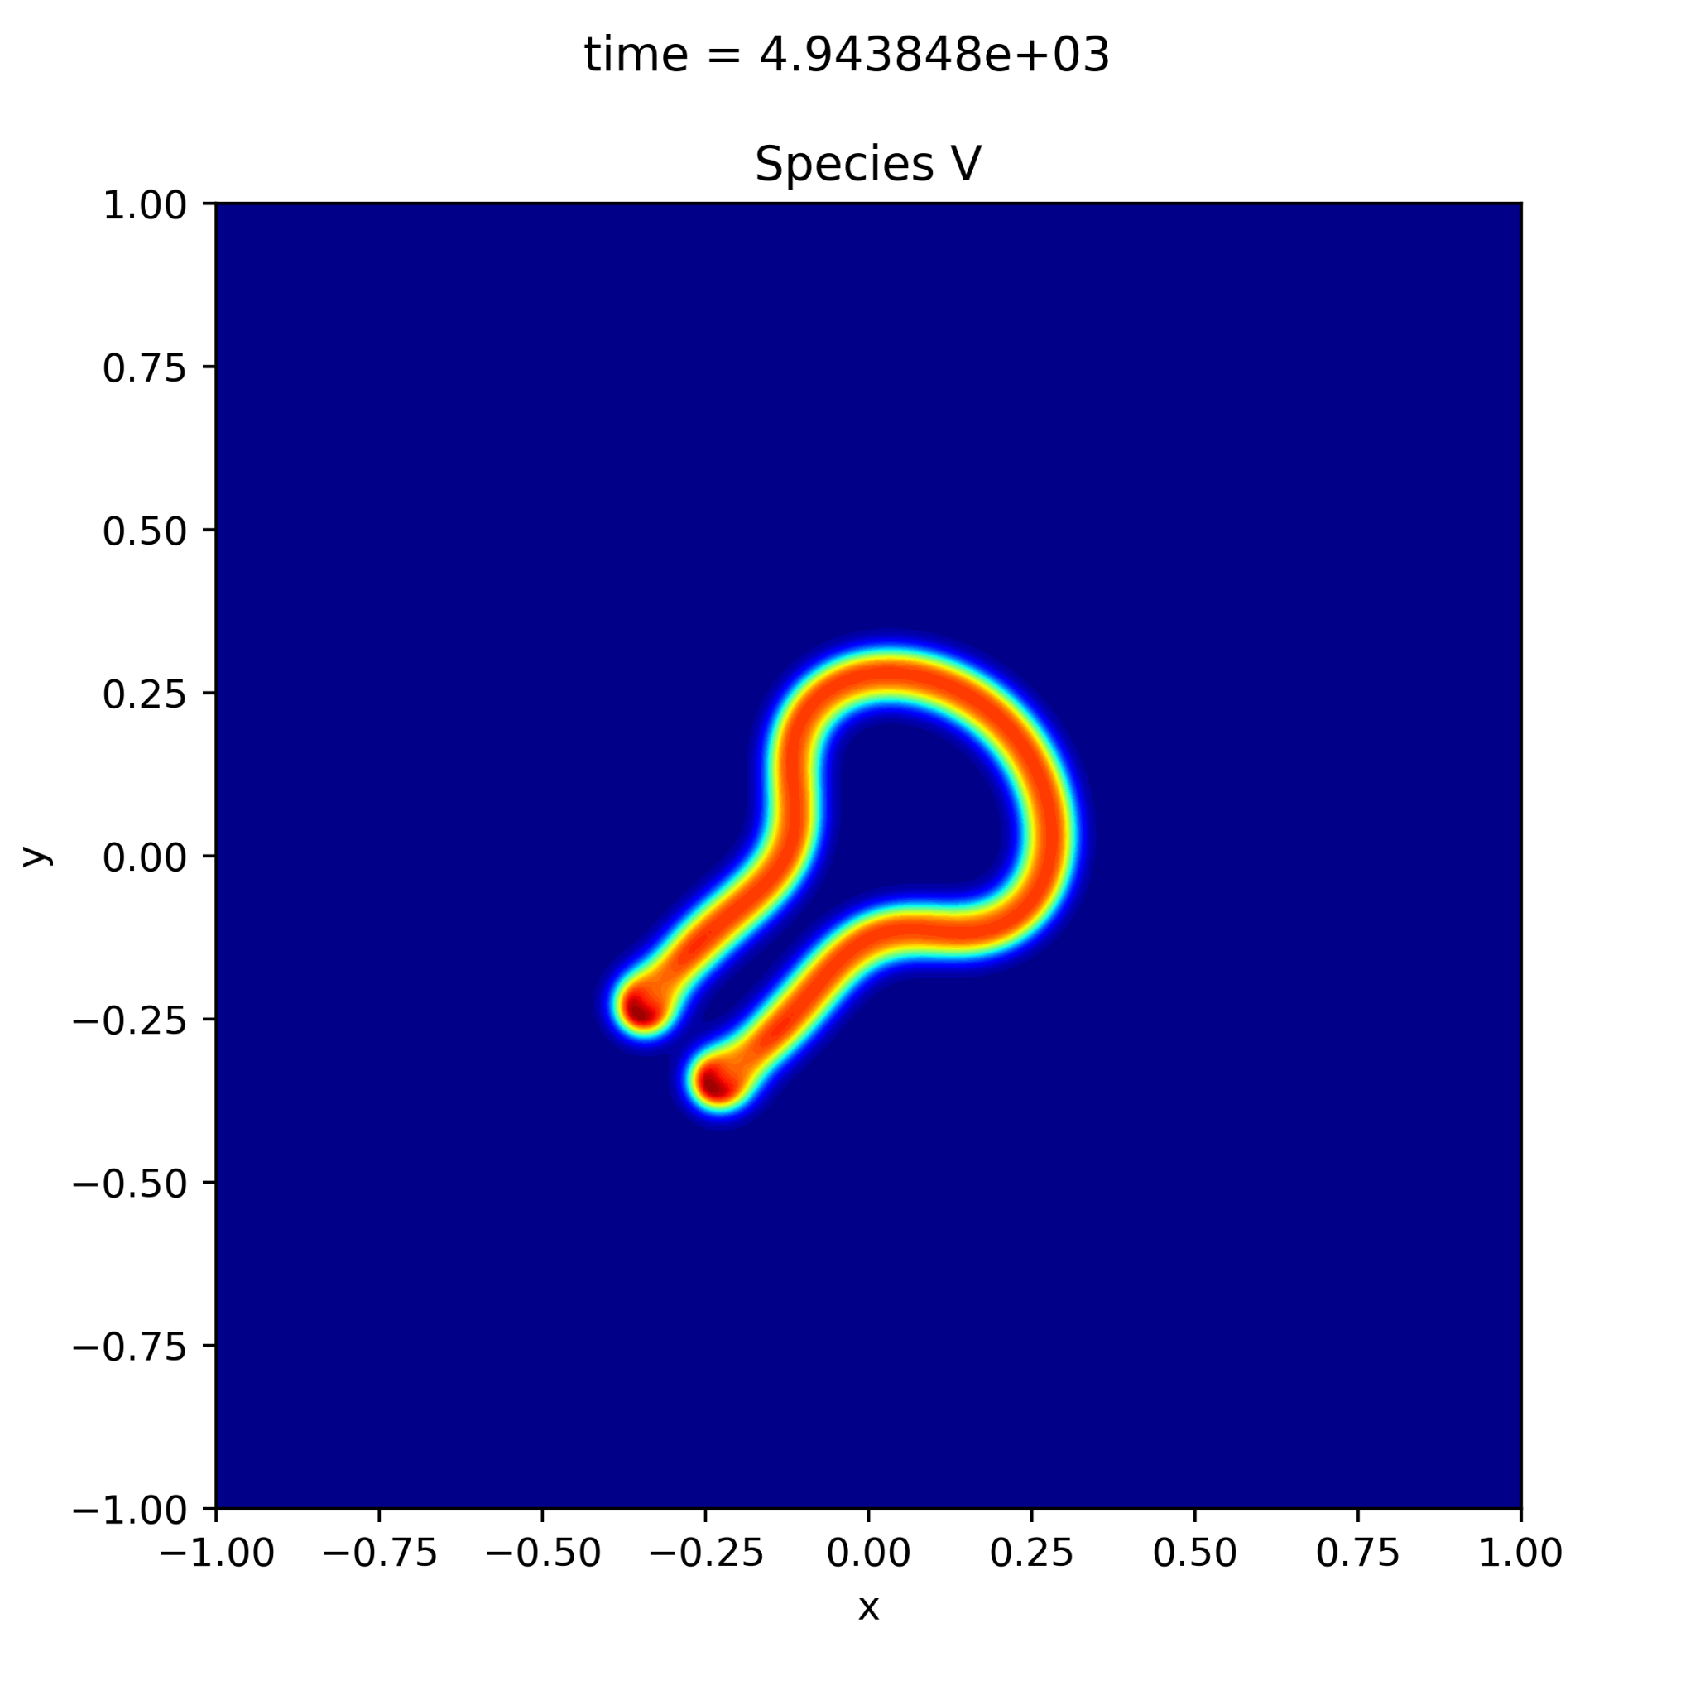
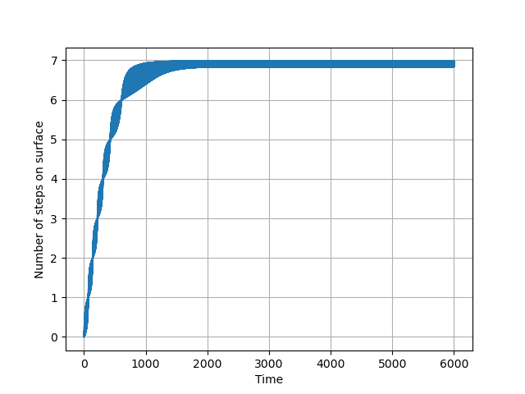
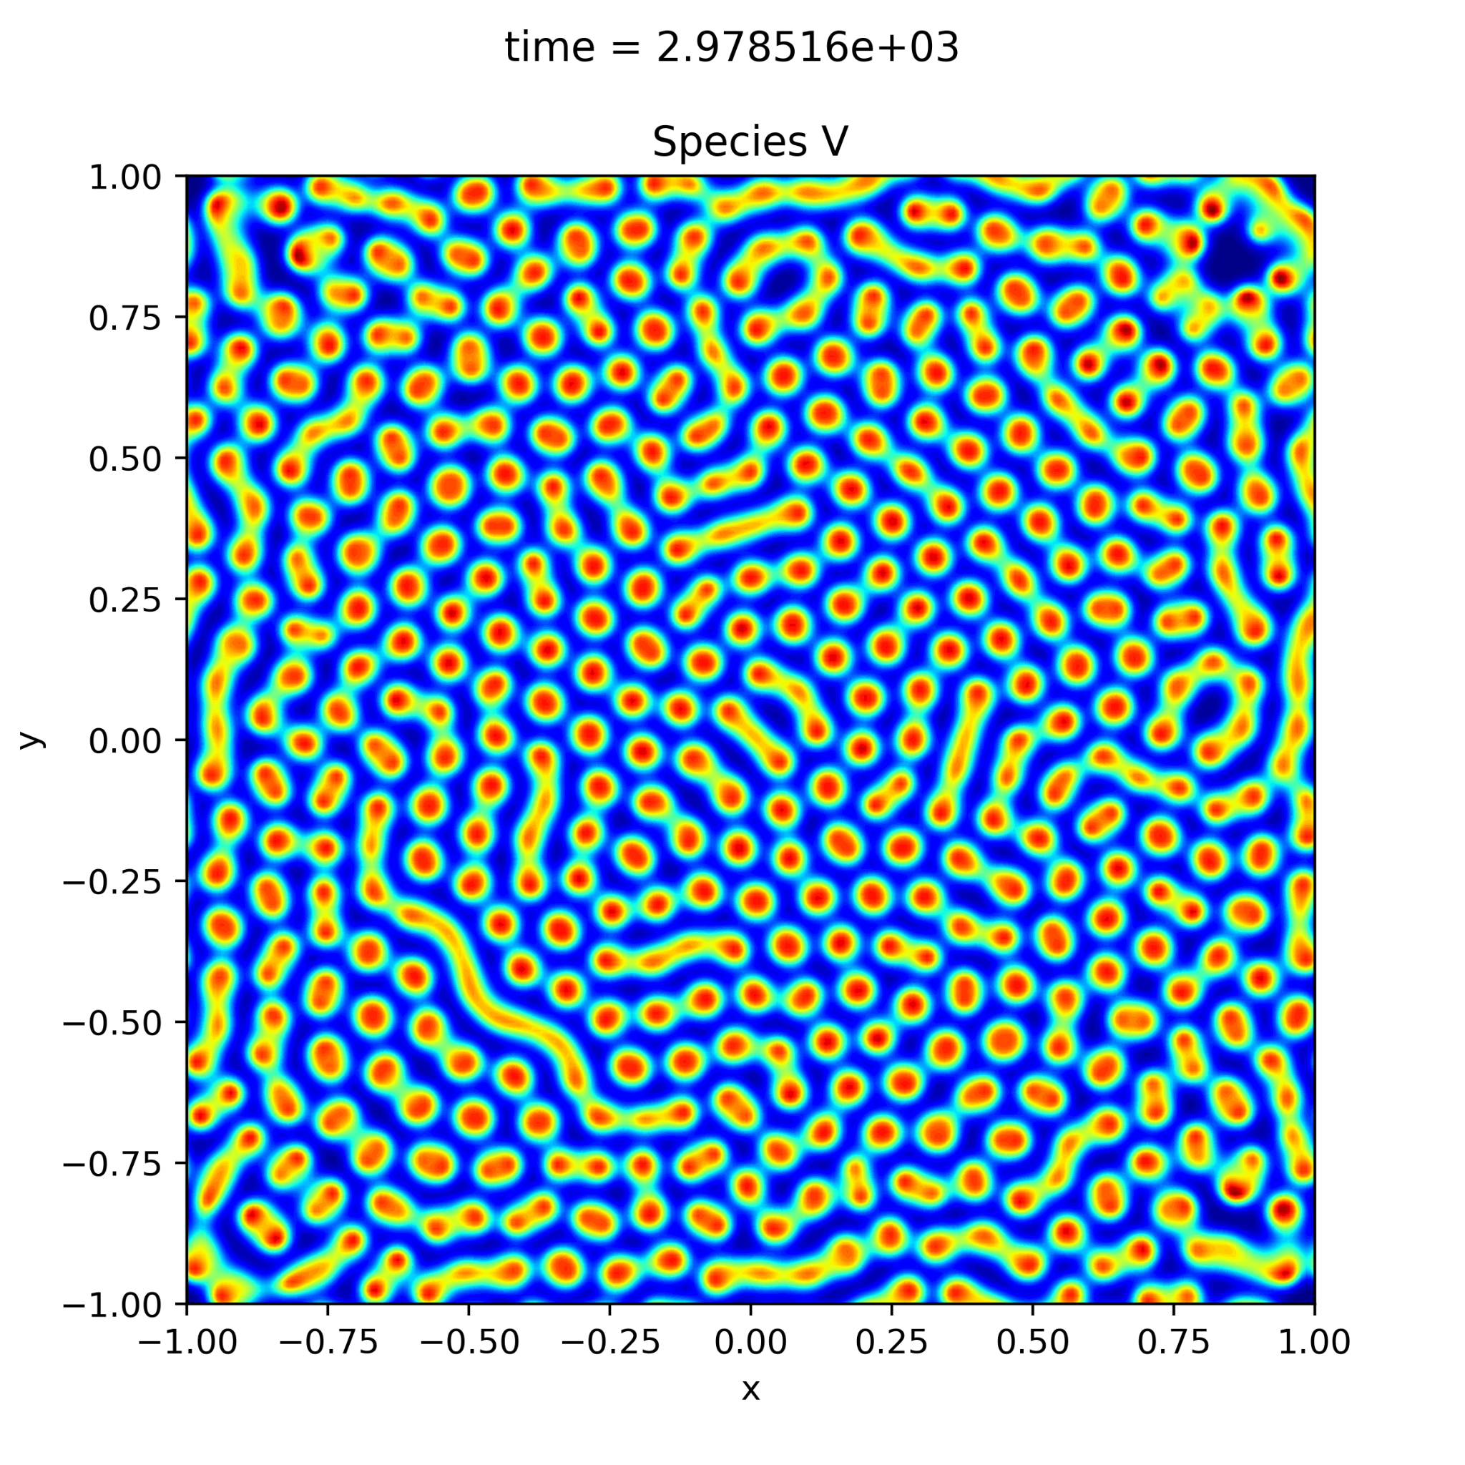
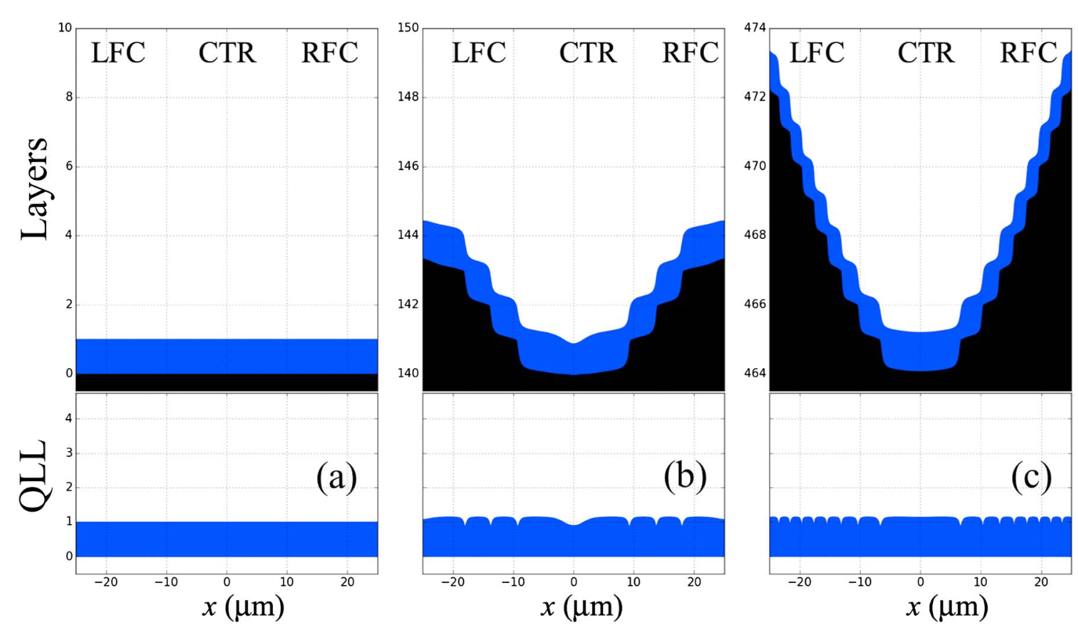

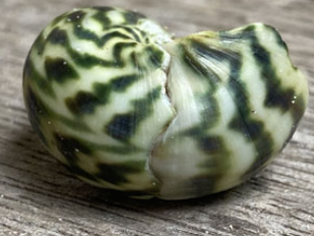
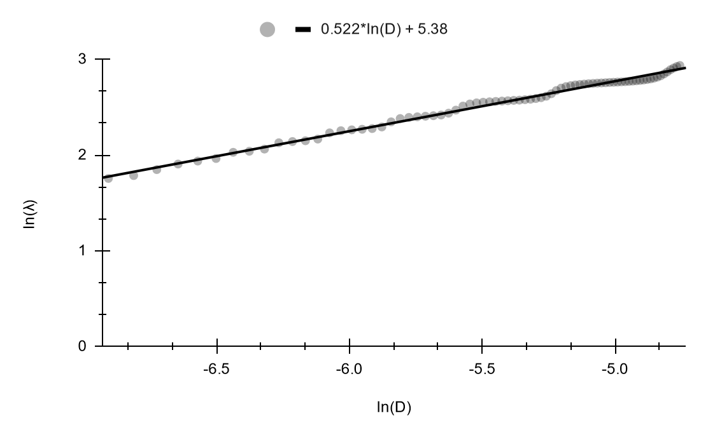
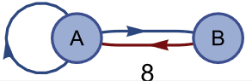
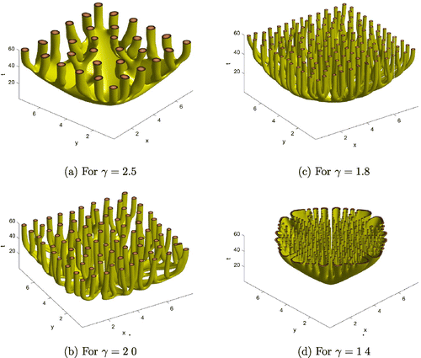
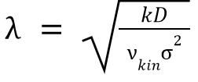
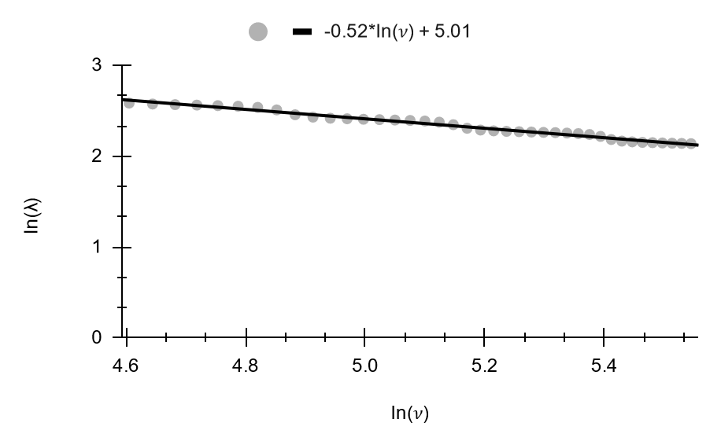
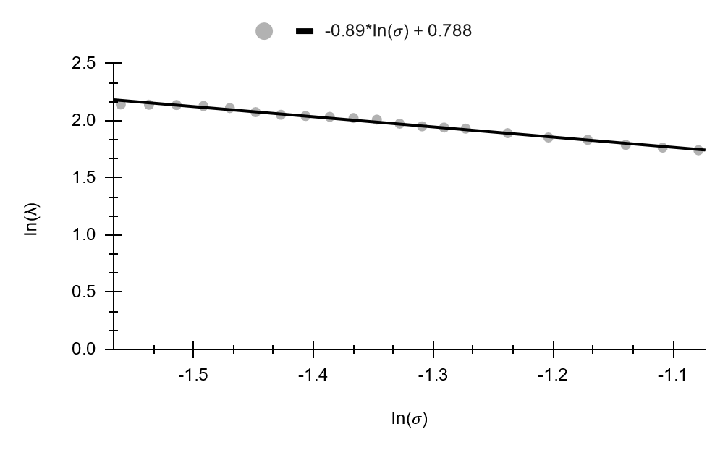
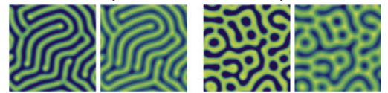
v
SAFETY - Keep all important elements, including text, at least 1/2-inch from edge of page.
Logos
Please do not reduce the size of these logos. The university logos provided here are sized to the smallest allowable size.
Do not alter the logos in any way. Do not change the colors of the logos. The university logo may appear in Maroon, Black, or White.
These laogos may be enlarged by clicking and dragging from the corners while holding down the shift key.
Please be sure to consult the Office of Communications Branding Guide when using the logo or when producing materials associated with the university:
About this template and saving as a PDF Using this template will ensure your publication is sized properly.
When you are finished with your design, save your publication as a PDF and upload it to your order.
To save your file as a PDF (for Windows):
Go to File, and choose Save As.
Select PDF from the “Save as type” dropdown menu.
Click “Save”.
A new window will pop up.
Choose any settings you need for saving your PDF (click the Options button).
Click “Save”
Be sure to review your PDF before submitting your order!
To save your file as a PDF (for Mac):
Go to File 🡪 Page Setup
Make note of the size of the slide (your poster) and click the Options button. A new window will open.
Click the plus icon in the lower left.
In the Paper Size field enter your slide’s shortest dimension as the width, and the longest dimension as the height. (It does not matter if your poster is portrait or landscape: shortest=width, longest=height).
Select your new custom size, and click Portrait or Landscape to match the layout of your poster. Then click OK.
Go to File → Print. A new window will open.
In the lower left corner of the window, click the PDF button and choose Save as PDF.
In the new window that opens make sure that “Hide extension” is unchecked. To view this option, it may be necessary to expand the window by clicking the small triangle next to your file name. The triangle should be pointing down.
Click Save.
Be sure to review your PDF before submitting your order!
If you have any questions please feel free to contact Print & Copy Services at 253.879.3737 or email us at print@pugetsound.edu.
Does Faceted Ice Growth Follow a Characteristic Pattern
Spencer Racca-Gwozdzik, Jake Price, Steven Neshyba
University of Puget Sound
v
v
Introduction
Methods
Results Cont.
In Cirrus clouds, ice growth is faceted which is different from normal growth that producers snow flakes.
In one dimensional faceted growth crystals grow on the whole spatial domain, not only at the edges.
Prismatic (side) facets are modeled and affect how the crystal and cloud as a whole reflects and absorbs light.
Prismatic facets are also periodic around the crystal.
Between ice crystals and the surround water vapor, there is a Quasi-Liquid Layer (QLL) of water molecules that affects the rate the crystal grows.
The ice model is a system of reaction diffusion equations that describe how the layers of ice and QLL change over time on a spatial domain.
Two Methods of investigating Turing Patterns were used.
Comparing known Turing pattern models to the ice system
Assuming a Turing like pattern exists and testing parameters to find wavelength dependence
In Turing systems, the wavelength of an
observed pattern, is proportional to the
square root of the Diffusion (Ouyang).
λ = kD^{1/2}, where k is a constant.
The wavelength, λ was defined as the
the length of the facet (L) divided by
Number of Steps at
steady state (N_{SS}).
Multiple simulations and tests were used on the ice system to find a Turing pattern.
These tests revealed key differences between the ice model and other known Turing systems.
www.pugetsound.edu/about/offices--services/office-of-communications/brand-guide--logo/
University of Puget Sound Accessibility Statement
The university requires all printed materials promoting events (including but not limited to posters, postcards, and event programs ) that are held on campus to include the following accessibility statement (also located on the template):
Puget Sound is committed to being accessible to all people. If you have questions about event accessibility, please contact accessibility@pugetsound.edu or visit pugetsound.edu/accessibility.
Roughness on a prismatic ice crystal facet.
The System of equations used to model ice growth.
The Result of a Turing pattern simulation fitted closer to the ice model.
More typical results from the same Turing pattern simulation run for a similar amount of time.
Layers Grown
Future Work
A plot showing the number of steps increasing as more layers of ice are grown and steady state is reached.
Investigate the relationship between λ and other parameters.
Find the value of k once all parameters are tested.
Retest λ proportionality with updated code in the fourier domain.
A Cirrus Cloud.
Publication Checklist:
[ ] Does your publication include all necessary information? - who, what, where, when, why - title(s) of the event - images and photo credits - ticket information - sponsors - contact information - website - accessibility information
[ ] Did you proof-read your publication?
[ ] Does it have the university’s accessibility statement?
[ ] Does it have the university logo on it?
[ ] Did you save it as a PDF?
[ ] Is your publication the correct size for what you want printed?
For more tips on designing and creating your publication, visit:
Turing Theory
Results of the ice model in one dimension.
References
Turing patterns can form in reaction diffusion systems of two or more species.
Turing patterns are responsible for real life phenomenon like zebra stripes, coral growth, and snail shell patterns.
A Turing pattern could describe the roughness pattern that forms as ice grows because the ice model is a reaction diffusion system.
A potential Turing system requires specific parameter values to produce a Turing pattern.
Results
Neshyba, S.; Adams, J.; Reed, K.; Rowe, P. M.; Gladich, I. A Quasi-Liquid Mediated Continuum Model of Faceted Ice Dynamics. Journal of Geophysical Research: Atmospheres 2016, 121 (23), 14,035-14,055.
Ouyang, Q.; Li, R.; Li, G.; Swinney, H. L. Dependence of Turing Pattern Wavelength on Diffusion Rate. The Journal of Chemical Physics 1995, 102 (6), 2551–2555.
Scholes, N. S.; Schnoerr, D.; Isalan, M.; Stumpf, M. P. H. A Comprehensive Network Atlas Reveals That Turing Patterns Are Common but Not Robust. Cell Systems 2019, 9 (3), 243-257.e4.
Somathilake, L. W.; Burrage, K. A Space-Fractional-Reaction-Diffusion Model for Pattern Formation in Coral Reefs. Cogent Mathematics & Statistics 2018, 5 (1), 1426524.
Vittadello, S.; Leyshon, T.; , Turing pattern design principles and their robustness.
Taking the natural log of both variables and graphing them allows the slope of the trendline to be the exponent on the independent variable and the y-intercept to be a proportionality constant.
λ = kD^{1/2} does fit the data because of the slope of about 0.5. (graph 1)
From testing other parameters, the λ relation can be expanded to . . (graphs 2 and 3)
(1)
Patterns on snail shells exhibit Turing patterns naturally.
(2)
(3)
www.pugetsound.edu/about/offices-services/office-of-communications/communications-resources/poster-tips/
Simulated coral reef growth using a reaction diffusion system that produces Turing patterns.
A Diffusion system that has potential to produce a Turing pattern. Species A is an activator of species B, and Species B inhibits Species A.
Acknowledgements
Thank you to Jake Price and Steven Neshyba for advising and providing support throughout the project and the Alan S. Thorndike Summer Research Endowed Fund for funding my research.
These graphs show how (1) the Diffusion Coefficient (D), (2) the kinetic growth velocity (𝜈_{kin}), and (3) the supersaturation (𝜎) effect λ. Because the natural logs of the parameters is being plotted, the slope shows the exponent in the relation, and the y-intercept represents a constant for the remaining unchanged parameters. From this, the revised λ relationship is , where k is a constant.
Images of the Turing pattern resulting from the pictured system.
PRINTED BY PRINT & COPY SERVICES AT UNIVERSITY OF PUGET SOUND | PUGETSOUND.EDU/PCS
v

